Slide 1
Flow chart elements
Start
Data
End
Process
Additional
steps compared to the simple CNN
Decision

Slide 2
1) Basic CNN
Layerstructure
Environment
No
No
Accuracy sufficient?
Accuracy sufficient?
Optimizer & Hyperparameter
Train CNN
Yes
Evaluation
Yes
Take pictures
Label pictures
Data augmentation
Training data set
Data set
Standardize picture size
Test data set

Slide 3
2) CNN with Transfer Learning
Come up with a pretrained CNN
Extract individual sections
Layer structure
Environment
No
No
Accuracy sufficient?
Accuracy sufficient?
Optimizer & Hyperparameter
Train CNN
Yes
Evaluation
Yes
Take pictures
Label pictures
Data augmentation
Training data set
Data set
Standardize picture size
Test data set

Slide 4
3) CNN for TPU requirements
Layerstructure
Environment
No
No
Accuracy sufficient?
Accuracy sufficient?
Optimizer & Hyperparameter
Train CNN
Yes
Evaluation
Yes
2
a
Take pictures
Label pictures
a
Data augmentation
Training data set
Data set
Standardize picture size
Test data set

Slide 5
3) CNN for TPU requirements
2
Export
Convert
Compile
a
Implement into existing net
No
Accuracy sufficient?
Accuracy sufficient?
Test the CNN with the TPU
Yes
Further tests
Yes

Slide 6
4) CNN for TPU requirements with Transfer Learning
Come up with a pretrained CNN
Extract individual sections
Layerstructure
Environment
No
No
Accuracy sufficient?
Accuracy sufficient?
Optimizer & Hyperparameter
Train CNN
Yes
Evaluation
Yes
2
a
Take pictures
Label pictures
a
Data augmentation
Training data set
Data set
Standardize picture size
Test data set

Slide 7
4) CNN for TPU requirements with Transfer Learning
2
Export
Convert
Compile
a
Implement into existing net
No
No
Accuracy sufficient?
Accuracy sufficient?
Test the CNN with the TPU
Yes
Further tests
Yes

Slide 8
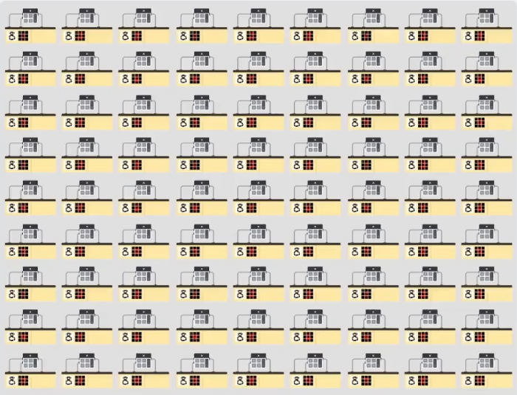
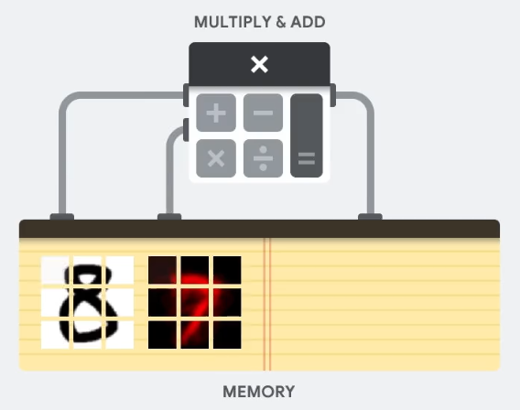
GPU
A single multiplier of the processor:
Input
(& software)

Slide 9
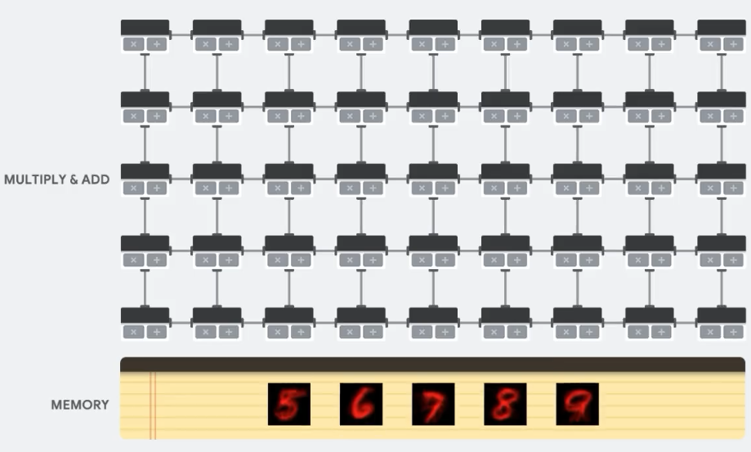
TPU
Input
Input
Input
Input
Input

Slide 10
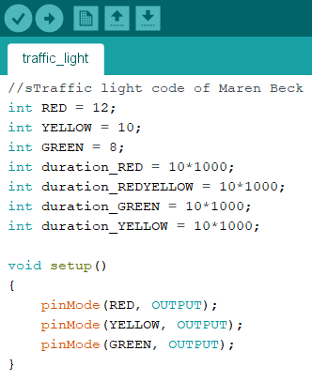
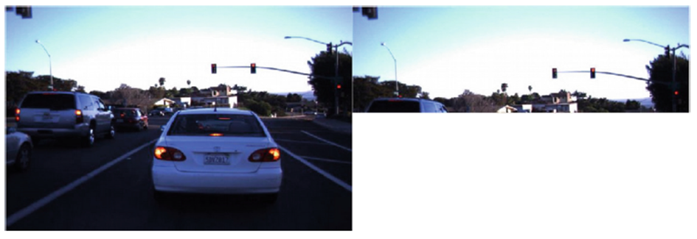
Arduino Nano
Image cropping

Slide 11
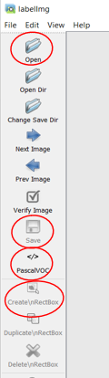
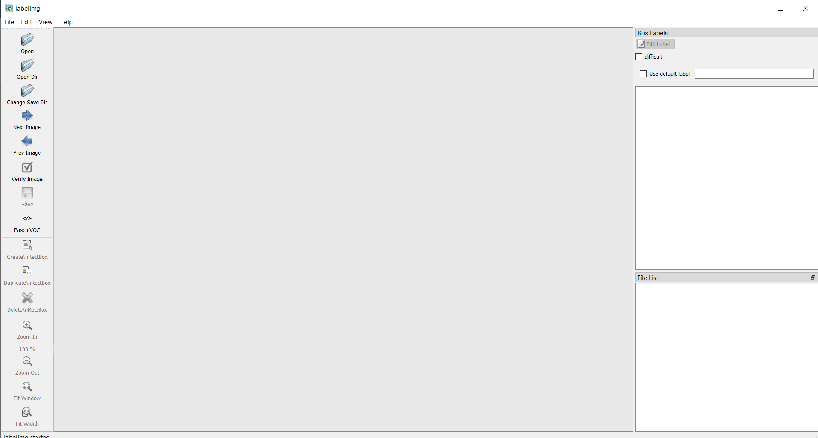
Image labelling
1
1
2
3
4
2
3
4

Slide 12

Truck project

Slide 13
Truck project
Traffic light status:
1 - Red
2 - Red-Yellow
3 - Green
4 - Yellow
1
2
3
4
1
2
3
4
Traffic light status:
1 - Red
2 - Red-Yellow
3 - Green
4 - Yellow
?
Colour identification
?
?

Slide 14
Theory content
CNN applications
Important software and hardware
CNN optimization approaches
Data set creation
CNN workflow
CNN applications
Important software and hardware
CNN optimization approaches
Data set creation
CNN workflow
Decoding facial recognition
Analyzing documents
Personalized advertising
Automatization techniques
Robot applications
Cars
Autonomous driving (i.e. Tesla)

Slide 15
Theory content
CNN applications
Important software and hardware
CNN optimization approaches
Data set creation
CNN workflow
Raspberry Pi
Arduino Nano
Jupyter Notebook
OpenCV
TensorFlow
Google Colab
GPU
TPU
CNN applications
Important software and hardware
CNN optimization approaches
Data set creation
CNN workflow
Faster R-CNN
BLOB detection
Image cropping
Vehicle to infrastructure
Colour spaces (HSV vs. RGB)

Slide 16
Theory content
CNN applications
Important software and hardware
CNN optimization approaches
Data set creation
CNN workflow
Image creation
Image labelling
Data augmentation
Different data sets
Integration to repository
CNN applications
Important software and hardware
CNN optimization approaches
Data set creation
CNN workflow
Basic CNN
CNN + Transfer learning
Basic CNN + TPU
CNN + Transfer learning + TPU

Slide 17
Practice content
Software set up
Simple neural network creation
Simple CNN creation
Truck project
Data set creation
CNN for traffic light detection
Software set up
Simple neural network creation
Simple CNN creation
Truck project
Data set creation
CNN for traffic light detection
WinSCP
VNC viewer
PuTTY
Arduino
Anaconda Prompt
Git
GitHub
Google Colab
Software set up
Simple neural network creation
Simple CNN creation
Truck project
Data set creation
CNN for traffic light detection
GitHub set up
Neural network environment
Network training
Saving
Save data in GitHub repository
Work with CSV data set
TFRecord

Slide 18
Practice content
Software set up
Simple neural network creation
Simple CNN creation
Truck project
Data set creation
CNN for traffic light detection
GitHub set up
Neural network environment
Network training
Saving
Save data in GitHub repository
Work with CSV data set
TFRecord
Install the basic libraries
Fork and clone
Load the data set

Slide 19
Practice content
Software set up
Simple neural network creation
Simple CNN creation
Truck project
Data set creation
CNN for traffic light detection
GitHub set up
Neural network environment
Network training
Saving
Save data in GitHub repository
Work with CSV data set
TFRecord
Pre-process data set
Layer structure
Training phase
Evaluation

Slide 20
Practice content
Software set up
Simple neural network creation
Simple CNN creation
Truck project
Data set creation
CNN for traffic light detection
GitHub set up
Neural network environment
Network training
Saving
Save data in GitHub repository
Unzip a data set
Install the basic libraries
Pre-process data set
Fork and clone
Layer structure
Load the data set
Training phase
Evaluation

Slide 21
Practice content
Software set up
Simple neural network creation
Simple CNN creation
Truck project
Data set creation
CNN for traffic light detection
Data set integration
Neural network environment
CNN training
Saving
Unzip a data set
Install the basic libraries
Pre-process data set
Fork and clone
Layer structure
Load the data set
Training phase
Evaluation

Slide 22
Practice content
Software set up
Simple neural network creation
Simple CNN creation
Truck project
Data set creation
CNN for traffic light detection
Introduction
First connection
Software set up
Simple neural network creation
Simple CNN creation
Truck project
Data set creation
CNN for traffic light detection
Image creation
Image labelling
Creation of test & training data set
Integration of data set into repository
Changing Arduino Nano program
Install labelimg
Image taking
Labelling with labelimg

Slide 23
Practice content
Software set up
Simple neural network creation
Simple CNN creation
Truck project
Data set creation
CNN for traffic light detection
Image creation
Image labelling
Creation of test & training data set
Integration of data set into repository
Changing Arduino Nano program
Install labelimg
Image taking
Labelling with labelimg
Install labelimg
Install Anaconda
Create a new environment in Anaconda
Open Anaconda Prompt
Change the file directory
Install labelimg
Start working with labelimg

Slide 24
Practice content
Software set up
Simple neural network creation
Simple CNN creation
Truck project
Data set creation
CNN for traffic light detection
Image creation
Image labelling
Creation of test & training data set
Integration of data set into repository
Changing Arduino Nano program
Install labelimg
Image taking
Labelling with labelimg

